Slide 1
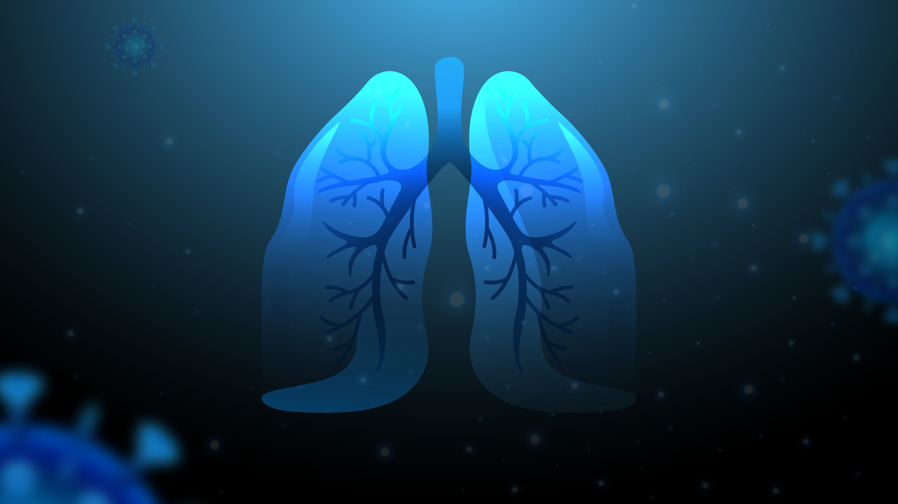

Pneumonia Detection
Done by: Ayah kouider
student ID:2104620

Slide 2



Table of Contents
Project Overview
01
Project Goal
Dataset
Methodology
02
Data preprocessing
Model architecture
Disscussion and results
03
Model evaluation
Feedback loop
Next steps.

Slide 3


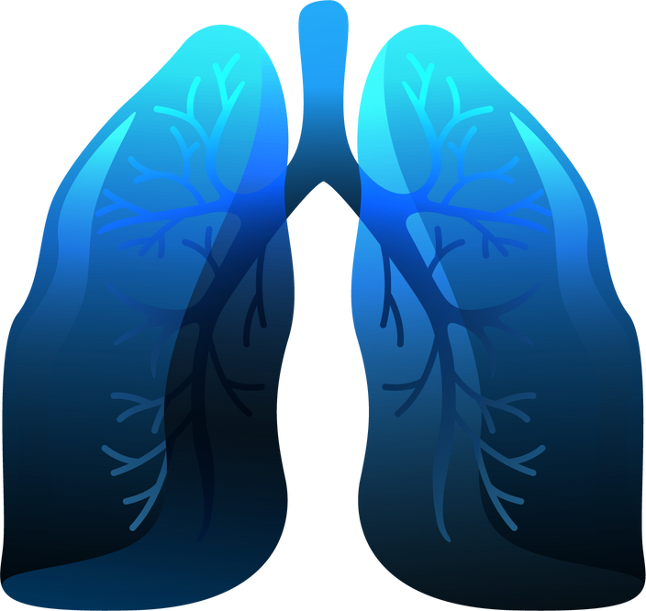
About the Disease
Global impact
one of the leading cause of death for children under 5
Challenges
Risk of delayed or missed diagnosis

Slide 4


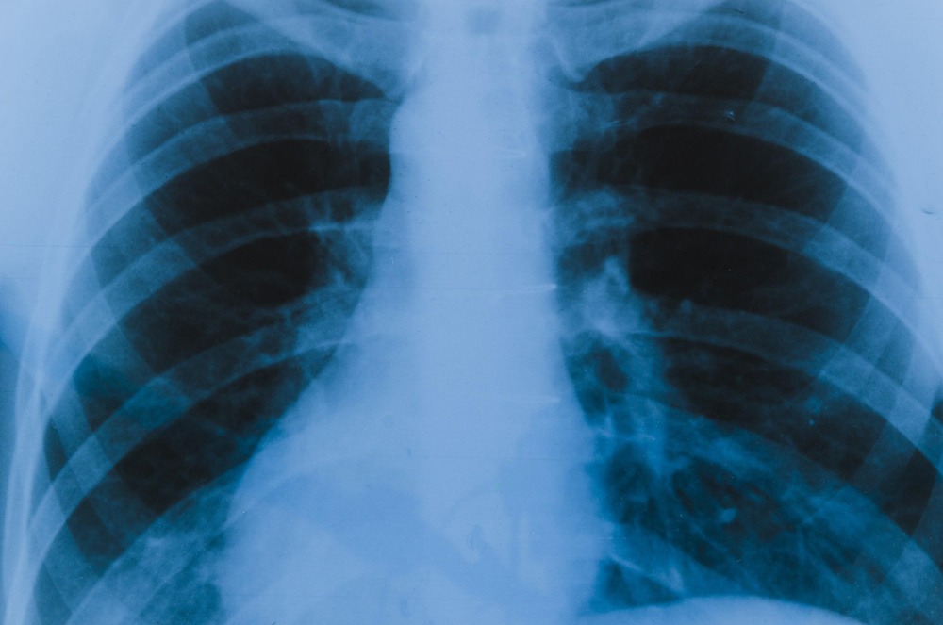
Dataset:RSNA Pneumonia Detection Challenge
Consists of approximatly 30,000 images in DICOM format.
2 csv files containing patient_ids,bounding boxes and targets/labels

Slide 5

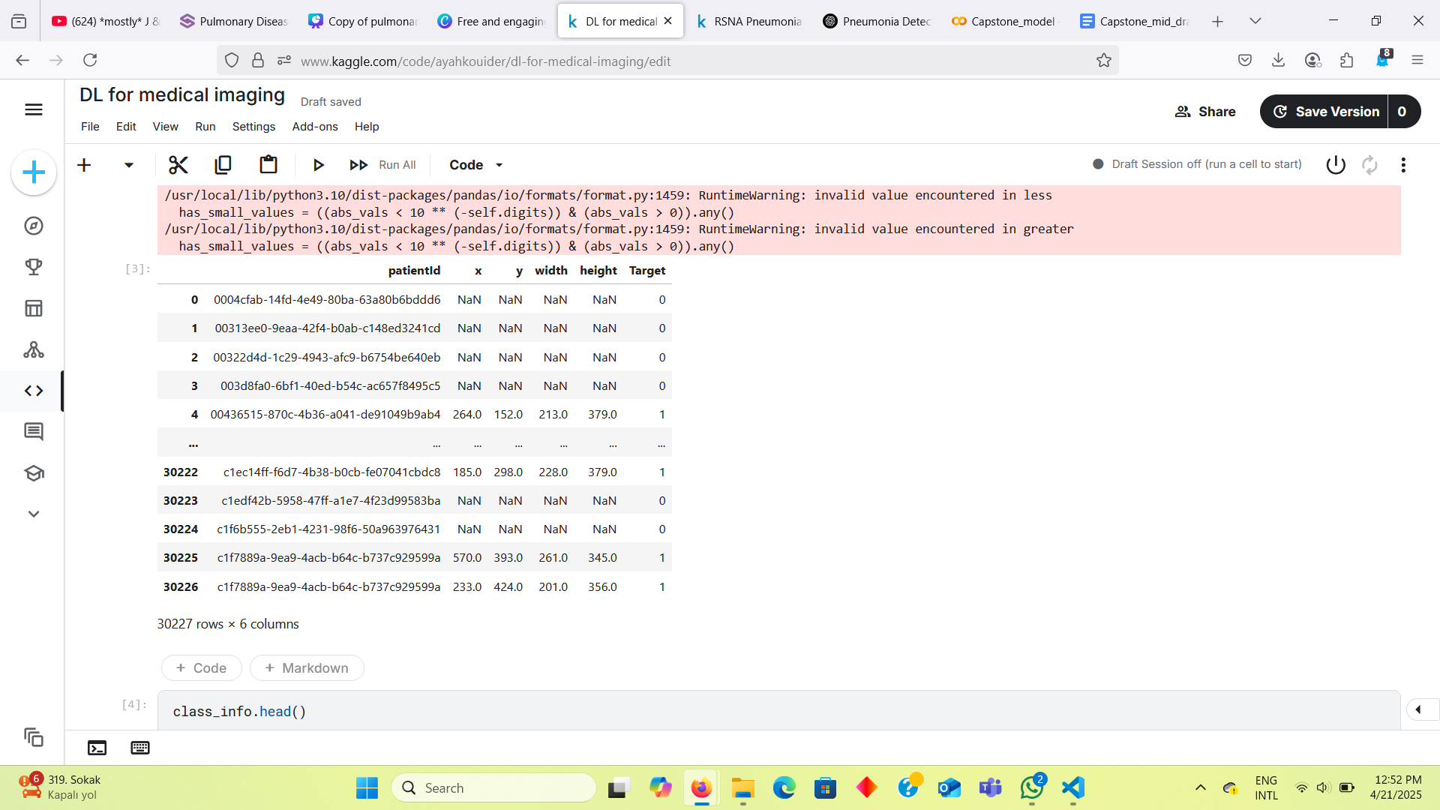
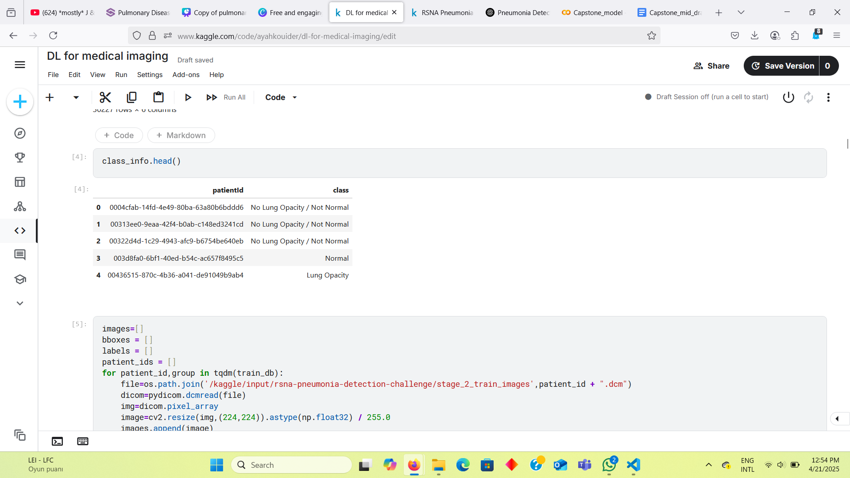
CSV files

Slide 6
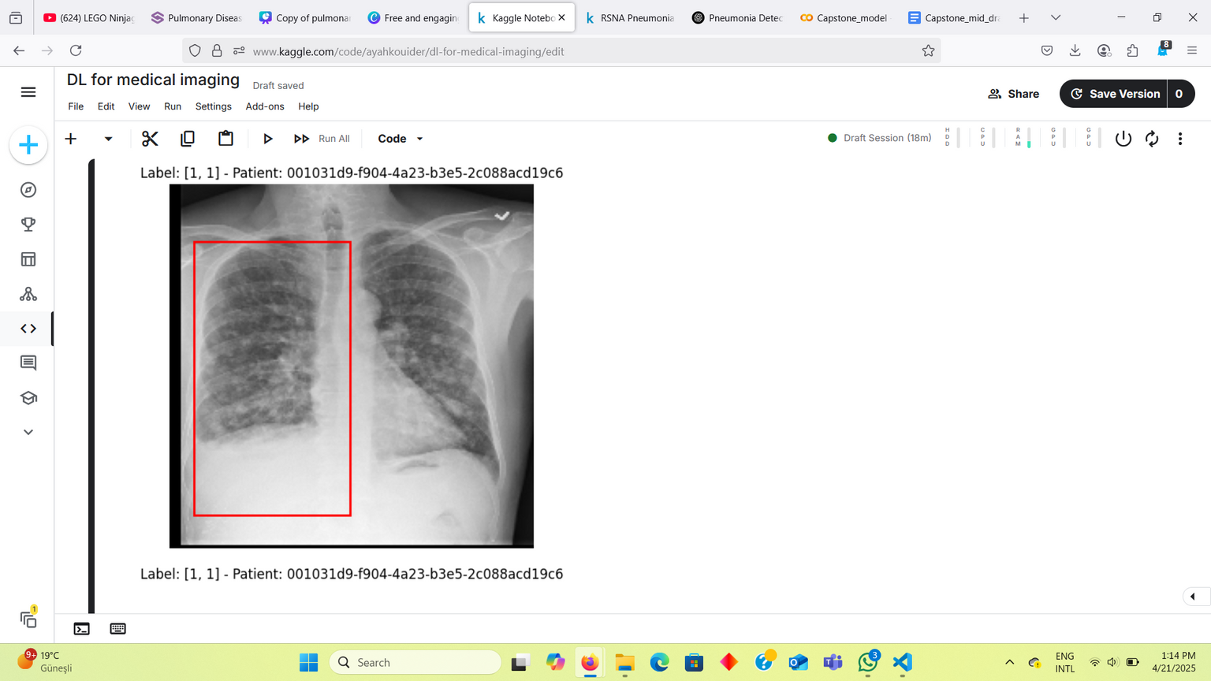
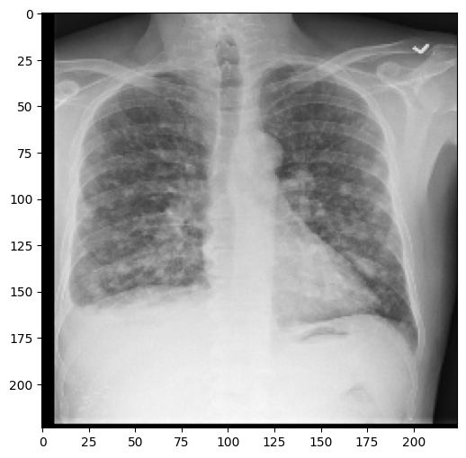
images and bboxes

Slide 7

Data preprocessing
Loaded DICOM images using pydicom.
Resized images.
Coverted bounding boxes to x1,y1,x2,y2 format.
Transformed targets to binary labels.
1 ⟶ pneumonia
0 ⟶ no pneumonia
Stored processed data into arrays.
Created a MedicalDataset to covert data into tensors.
Split the data into 80/20

Slide 8

Retinanet
Model architecture:
Training details:
Used adamW optimizer and lr_scheduler.
Trained the model for 10 epochs
Total training time:
First Run:10 hours on GPU T4
Final Run: 2.5 hours on GPU P100
One-stage object detector
Uses feature pyramid network (FPN) and focal loss

Slide 9

Fast-RCNN:
Model architecture:
Training details:
Trained the model for 10 epochs
Total training time: 2 hours ,
16 min per epoch
Region proposal based object detector.
Uses CNN backbone with ROI Pooling (Region Of Interest pooling) ,classification and bounding box regression.

Slide 10
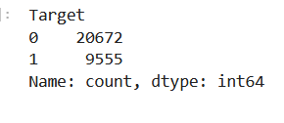
Data imbalance mitigation:
Undersampling.
Oversampling
Stratified Kfold
Weighted sampler
Training on only positive
.
Manual split. + undersampling + weighted sampler

Slide 11
Results
Models | precision | Recall | F1-score | AUC
Retinanet (normal data) | 1 | 0.0016 | 0.003 | 0.87
Retinanet (custom split and undersanpling) | 0.90 | 0.61 | 0.73 | 0.90
Fast- RCNN (custom split and undersampling) | 0.63 | 0.94 | 0.76 | 0.89
Ensemble (Retina + F-RCNN) | 0.63 | 0.99 | 0.77 | 0.88

Slide 12
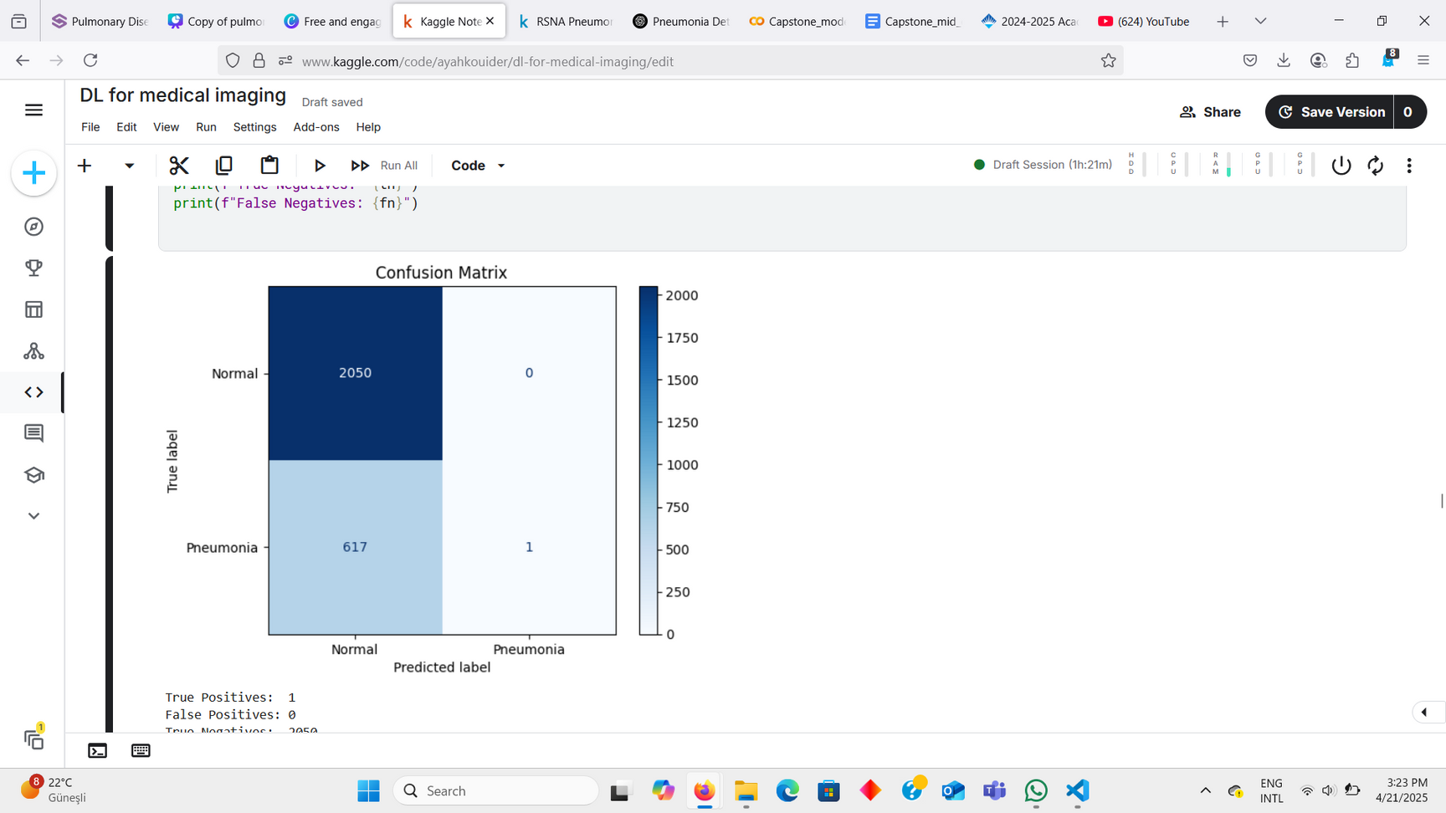
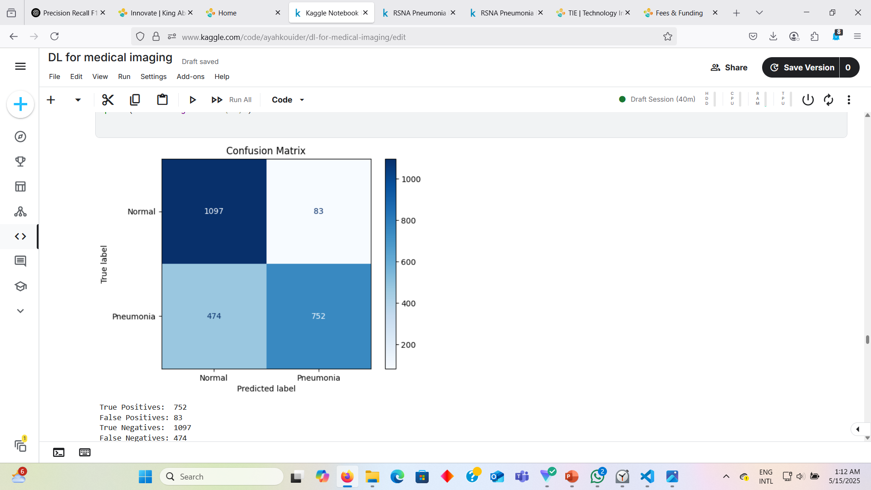
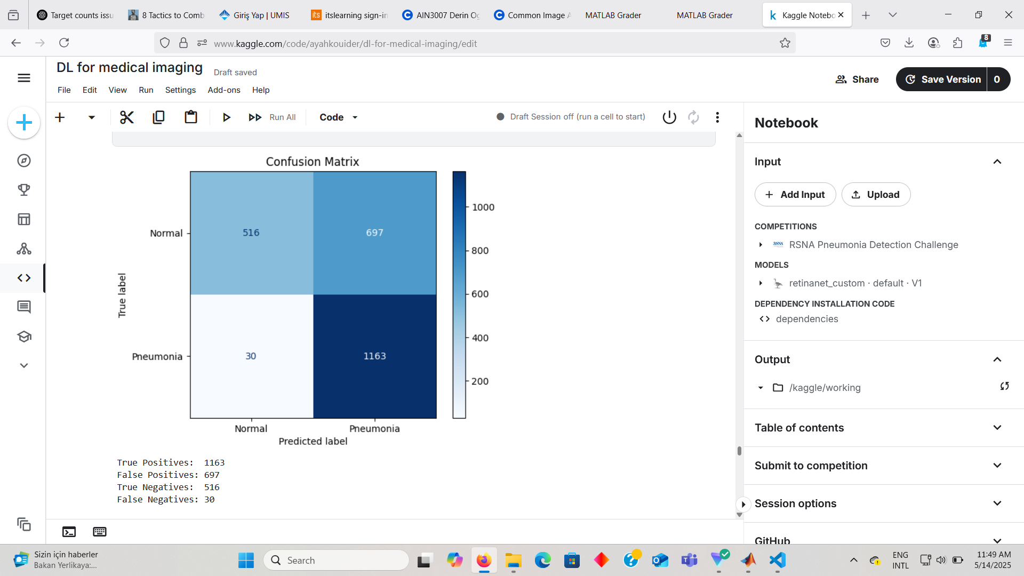

Comparison:
1st Retina model:
2nd Retina model
Fast-RCNN model
True Positives: 1
False Positives: 0
True Negatives: 2050
False Negatives: 617
True Positives: 752
False Positives: 83
True Negatives: 1097
False Negatives: 474
True Positives: 1163
False Positives: 679
True Negatives: 516
False Negatives: 30

Slide 13

Thank you for listening
Do you have any questions?
CREDITS: This presentation template was created by Slidesgo, including icon by Flaticon, and infographics & images from Freepik

